Slide 1
Shor’s Algorithm
Dr. William Hutton
Washington State University

Slide 2
What makes encryption hard?
Factoring large numbers
N = P₁ x P₂
Notes:
Some number, N, is the product of of two prime factors, P1 and P2.
For these examples, we will be using VERY small numbers.

Slide 3
What makes encryption hard?
Finding the prime factors of a very large non-prime number
N = P₁ x P₂
e.g., 15 = 3 x 5
Notes:
Some number, N, is the product of of two prime factors, P1 and P2.
For these examples, we will be using VERY small numbers.

Slide 4
Some notation
N is some large, non-prime integer
d = |N| is the cardinality (number of digits) in N.

Slide 5
Some notation
N is some large, non-prime integer
d = |N| is the cardinality (number of digits) in N.
Example
N = 2048 (still not a “large” number.
d = |N| = 4

Slide 6

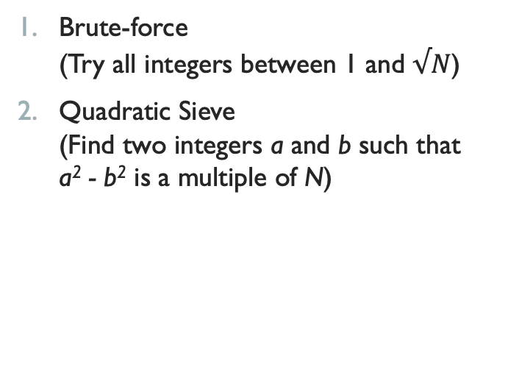
How Classical computers can find Factors
Brute-force (Try all integers between 1 and $√N$)
Quadratic Sieve (Find two integers a and b such that a² - b² is a multiple of N)
O($√N$) w.r.t. d
O($√d$^{1/3})

Slide 7
How Large is a Large Number N?
We often use 1,024, 2,048 or even 4,096-bit encryption.
If a byte is 8 bits {2⁷, 2⁶, 2⁵, 2⁴, 2³, 2², 2¹, 2⁰}:
Largest N = 2⁸ = 256, d = 3
If we use a 2,048-bit key (the minimum recommended now):
d = 617
It took a supercomputer 2,000 CPU years to factor N using the quadratic sieve method where d = 232.
Notes:
Experiment with your computer and let me know what is the largest integer w.r.t. “d” that you can factor?

Slide 8

How a quantum computer factors large numbers
Factoring very large numbers (e.g., d = 1,000) is hard.
Peter Shor challenged that assumption in 1995 with a polynomial time quantum algorithm for factoring.
Shor’s algorithm drove hardware research into the development of a real quantum computer.
Qubit: The fundamental unit of quantum computing. (Analogous to the bit of classic computers.)
Uses quantum superposition and interference.
Notes:
Peter Shor is an American professor of applied mathematics at MIT.

Slide 9
Shor’s Algorithm: Step-By-Step
Since 1970 we have known that factoring becomes easy if you can solve another hard problem:
finding the period of a modular exponential function
Period finding function:
Given integers N and a:
Find the smallest positive integer r s.t. (i.e. such that):
a^{r} -1 is a multiple of N.

Slide 10
#1 Period finding function
Period finding function:
Given integers N and a:
Find the smallest positive integer r s.t. (i.e. such that):
a^{r} -1 is a multiple of N.
N = 15
a = 7
Exponent | Modulus | Answer
7² | 49 % 15 = | 4
Notes:
We are given N.
Q: How do we get a?
A: We guess! (2 < a < N -1)

Slide 11
#1 Period finding function
Period finding function:
Given integers N and a:
Find the smallest positive integer r s.t. (i.e. such that):
a^{r} -1 is a multiple of N.
N = 15
a = 7 (guess s.t. 2 < a < N - 1)
Exponent | Modulus | Answer
7² | 49 % 15 = | 4
7³ | 343 % 15 = | 13

Slide 12
#1 Period finding function
Period finding function:
Given integers N and a:
Find the smallest positive integer r s.t. (i.e. such that):
a^{r} -1 is a multiple of N.
N = 15
a = 7 (guess s.t. 2 < a < N - 1)
Exponent | Modulus | Answer
7² | 49 % 15 = | 4
7³ | 343 % 15 = | 13
7⁴ | 2401 % 15 = | 1

Slide 13
#1 Period finding function
Period finding function:
Given integers N and a:
Find the smallest positive integer r s.t. (i.e. such that):
a^{r} -1 is a multiple of N.
N = 15
a = 7 (guess s.t. 2 < a < N - 1)
Exponent | Modulus | Answer
7² | 49 % 15 = | 4
7³ | 343 % 15 = | 13
7⁴ | 2,401 % 15 = | 1
7⁵ | 16,807 % 15 = | 7

Slide 14
#1 Period finding function
Period finding function:
Given integers N and a:
Find the smallest positive integer r s.t. (i.e. such that):
a^{r} -1 is a multiple of N.
N = 15
a = 7 (guess s.t. 2 < a < N - 1)
Exponent | Modulus | Answer
7² | 49 % 15 = | 4
7³ | 343 % 15 = | 13
7⁴ | 2,401 % 15 = | 1
7⁵ | 16,807 % 15 = | 7
7⁶ | 117,649 % 15 = | 4

Slide 15
#1 Period finding function
Period finding function:
Given integers N and a:
Find the smallest positive integer r s.t. (i.e. such that):
a^{r} -1 is a multiple of N.
N = 15
a = 7 (guess s.t. 2 < a < N - 1)
Exponent | Modulus | Answer
7² | 49 % 15 = | 4
7³ | 343 % 15 = | 13
7⁴ | 2,401 % 15 = | 1
7⁵ | 16,807 % 15 = | 7
7⁶ | 117,649 % 15 = | 4
7⁷ | 823,543 % 15 = | 13

Slide 16
#1 Period finding function
Period finding function:
Given integers N and a:
Find the smallest positive integer r s.t. (i.e. such that):
a^{r} -1 is a multiple of N.
7^{x+4} = 7^{x} (mod 15)
Thus, r=4
N = 15
a = 7 (guess s.t. 2 < a < N - 1)
Exponent | Modulus | Answer
7² | 49 % 15 = | 4
7³ | 343 % 15 = | 13
7⁴ | 2,401 % 15 = | 1
7⁵ | 16,807 % 15 = | 7
7⁶ | 117,649 % 15 = | 4
7⁷ | 823,543 % 15 = | 13
Period (r = 4)
Notes:
The pattern repeats (proof by induction), therefore, r=4.

Slide 17
#1 Period finding function
Period finding function:
Given integers N and a:
Find the smallest positive integer r s.t. (i.e. such that):
a^{r} -1 is a multiple of N.
7^{x+4} = 7^{x} (mod 15)
Thus, r=4
N = 15
a = 7 (guess s.t. 2 < a < N - 1)
Exponent | Modulus | Answer
7² | 49 % 15 = | 4
7³ | 343 % 15 = | 13
7⁴ | 2,401 % 15 = | 1
7⁵ | 16,807 % 15 = | 7
7⁶ | 117,649 % 15 = | 4
7⁷ | 823,543 % 15 = | 13
Period (r = 4)
Notes:
The pattern repeats (proof by induction), therefore, r=4.

Slide 18
#1 Period finding function
Period finding function:
Given integers N and a:
Find the smallest positive integer r s.t. (i.e. such that):
a^{r} -1 is a multiple of N.
7^{x+4} = 7^{x} (mod 15)
Thus, r=4
This problem is well-defined when N and a are co-prime.
N = 15
a = 7 (guess s.t. 2 < a < N - 1)
Exponent | Modulus | Answer
7² | 49 % 15 = | 4
7³ | 343 % 15 = | 13
7⁴ | 2,401 % 15 = | 1
7⁵ | 16,807 % 15 = | 7
7⁶ | 117,649 % 15 = | 4
7⁷ | 823,543 % 15 = | 13
Period (r = 4)
Notes:
Q: What does “well-defined” mean?
A:
A well-defined function is a definition that really gives you a function. i.e. the output doesn’t change when the representation of the input does (but the value stays the same).
An example is f(a/b) = a + b. For ½ y = 3, but for 2/4, y = 6. Different output when the input is changed, but the value remains the same.
Q: What does co-prime mean? A: (No common factors… other than 1 of course).

Slide 19
#2 Improving our guess
Remember how we got a?
Improving our random guess for a takes a L O N G time with a classical computer, but it is extremely quick with a quantum computer because of interference.
We don’t have to guess the exact factors of N, a factor of a factor is OK, too.
(e.g. N = p1 x p2).
(E.g., 4 is not a factor of 6, but they both have a common factor of 2.)
We’ll use Euclid’s GCD function from the 4th century BCE!
Notes:
We guessed!

Slide 20
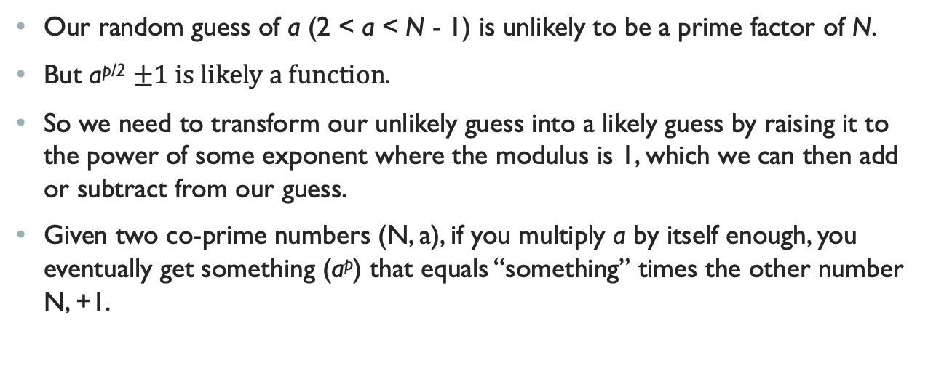
Why the modular exponent function works
Our random guess of a (2 < a < N - 1) is unlikely to be a prime factor of N.
But a^{p/2} $±1 is likely a function.$
So we need to transform our unlikely guess into a likely guess by raising it to the power of some exponent where the modulus is 1, which we can then add or subtract from our guess.
Given two co-prime numbers (N, a), if you multiply a by itself enough, you eventually get something (a^{p}) that equals “something” times the other number N, +1.

Slide 21
An example
(a, N)
a^{p} = m x N + 1
N = 15
a = 7
Exponent | Modulus | Answer
7² | 49 % 15 = | 4
7³ | 343 % 15 = | 13
7⁴ | 2401 % 15 = | 1
7⁴ = 2401 = 160 x 15 + 1

Slide 22
An example
(a, N)
a^{p} = m x N + 1
This works for ANY pair of numbers that do not share factors. (i.e. are co-prime!)
Try it with (42, 13)
N = 15
a = 7
Exponent | Modulus | Answer
7² | 49 % 15 = | 4
7³ | 343 % 15 = | 13
7⁴ | 2401 % 15 = | 1
7⁴ = 2401 = 160 x 15 + 1
Notes:
42^3 = 74,088 = 5,699 * 13 + 1 (Show in Python?)

Slide 23
Now we have…
a^{p} = m x N + 1
Which can be re-written as:
a^{p} - 1= m x N
(a^{p/2} +1) x (a^{p/2} -1) = m x N
Notes:
This is what we are trying to find!
Something x Something = N. (The two prime factors used in our encryption algorithms!)

Slide 24
Back to our example
a^{p} = m x N + 1
Which can be re-written as:
a^{p} - 1= m x N
(a^{p/2} +1) x (a^{p/2} -1) = m x N
(7^{4/2} +1) = 50
(7^{4/2} -1) = 48
These are obviously not factors of N. But we can find their GCDs with N (i.e. 15) using Euclid’s algorithm!
Notes:
50 and 48 are not factors of 15, but they have common factors with 15, which we can find using Euclid’s GCD!

Slide 25
GCD(48, 15) and GCD(50,15)
48 |  | 50 |  | 15
1 | 48 | 1 | 50 | 1 | 15
2 | 24 | 2 | 25 | 3 | 5
3 | 16 | 5 | 10
4 | 12
6 | 8

Slide 26
We’re done right?
No. There are three problems with this approach for classical computers!
(a^{p/2} +1) x (a^{p/2} -1) = m x N
One of the terms on the LHS (i.e. left-hand side) might be a factor of N.
The other term on the LHS would be a factor of m. Making both terms useless to finding P₁ and P₂ of N.
The exponent p in the LHS terms might be odd, meaning our terms on the LHS will probably be real numbers, not integers.
How do we find a p that works?
Notes:
3/8 of the time, our random guess of “a” works. That’s 37.5% of the time. 99% of the time we can do it in 10 tries.
Recall “p” is how many times we have to multiply our guess by to get a multiple of N + 1.
However, for very large “d” (number of digits, like d = 1,000 for some N.). This is actually SLOWER than brute force if our guess is say, 500 digits long.

Slide 27
How Quantum Computing solves these problems
Classical computer
1 input
1 answer
E.g., f(x) = x² (3, 9)
Quantum computer
Simultaneously compute multiple answers for a single input using superposition
Each answer has a potential probability, but only one answer is returned.
E.g., {1, 2, 3} f(x) {1, 4, 9} = 4

Slide 28
Fast and Reliable Quantum Computations
1. Set up a quantum superposition that calculates all the possible answers at once.
2. Arranged so that all the wrong answers destructively interfere with each other, leaving only the correct answer using Shor’s algorithm and a quantum Fourier transform.
Notes:
(2) This is what Shor’s algorithm does!
It puts a problem (finding the power “p”) in a form where all the wrong answers destructively interfere with each other.
https://youtu.be/lvTqbM5Dq4Q?list=WL&t=517 (Shor’s algorithm)
https://youtu.be/lvTqbM5Dq4Q?list=WL&t=774 (Quantum Fourier transform)

